Slide 1
Query Execution

Slide 2
Welcome
Get a VM:
sabiniotrXX.westeurope.cloudapp.azure.com
Login
.\SQLTraining
SQLTraining123
Wifi
Username: huddle
Password: wCKEgk

Slide 3
Todays Objectives
How SQL Server generates a query plan
When plans are and are not reused
How to read a query plan
Why query plans sometimes get it wrong

Slide 4
Query Plans

Slide 5
How do queries Execute?
Plan is generated
Execution engine waits for resources
Enough memory (space to execute the query) – not strictly fifo
Available scheduler (CPU)
Results returns/data modified

Slide 6
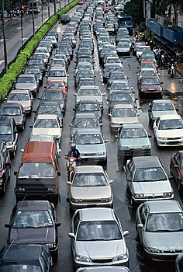
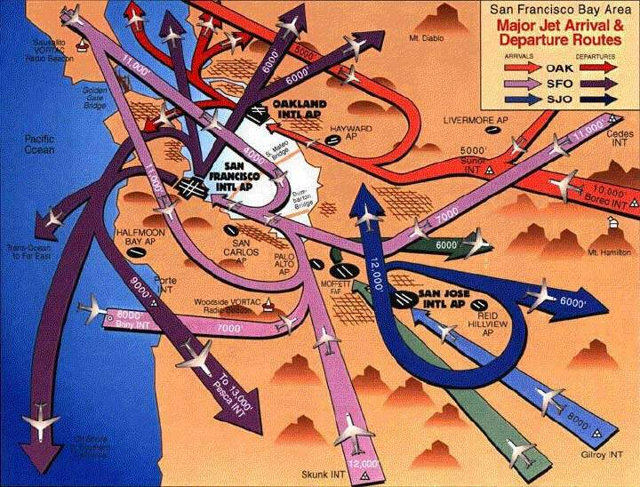

Understanding resources
Notes:
Cars queue in order for each CPU – they can switch lanes if one is moving faster. The motorbike could be in a separate resource governor pool.
The beach is like memory, if its full we can’t grant the execution space required and must wait (Memory Grant Pending)
Map of flight paths is like acquiring locks, we must follow a path (hierarchy) to reduce the chance of collisions – this causes queueing. Not just data pages but system pages in tempdb.
No mention of disk – all we care about here is memory, we will wait for disk when we start to execute

Slide 7
What is a Plan?
Calculated method to complete a given task
Estimates resources required
Cost (CPU/Memory)
How?
Indexes
Statistics
Hints
Estimated Plans vs Actual Plans
Actually the same thing, one just has the actual counts/cost during execution

Slide 8
Query Plans
Cost
Operators
Seeks/Scans
Joins
Sorting
Calculations
Indexing
Covering indexes
Sort order
Estimation

Slide 9
Cost
Is based on a machine many years ago
Doesn't equate to anything specific
Useful for comparison
Shouldn't be used in isolation
Doesn't consider server state
Available memory
Pages in memory already
High end disk (ram disk, SSD)

Slide 10
Building a Plan
Seek vs Scan
Choosing an Index
Cardinality
Covering vs Non Covering
Filtered Indexes
Plan Guides

Slide 11
Estimates
Plans are based on estimates
Based on statistics or fixed estimates
Statistics need updating
Especially where distributions change
i.e. time based data
Query has to run to get actuals

Slide 12
Statistics
Histogram of column(s) contents
Calculates the cardinality of a column (uniqueness of values)
Estimated from a sample (usually)
Always exist for indexes
Auto generated (usually) on other columns if used as predicates
Never auto generated on multiple columns (except indexes)
Manually update with UPDATE STATISTICS

Slide 13
Statistics Histogram
Notes:
Histogram shows skew for values between 141 and 160. If the plan is generated from a value in this range then it maybe off
Maximum 200 ranges calculated

Slide 14
Demo – Out of Date Statistics
Notes:
During this demo explain the parts of the query plan
DBCC SHOW STATS:
RANGE_HI_KEY – Upper bound of the key value
RANGE_ROWS – Estimated number of rows in range (excluding key)
EQ_ROW – Estimated number of matching rows
DISTINCT_RANGE – Estimated number of distinct values in range (excluding key)
AVG_RANGE_ROWS – Average number of duplicates

Slide 15
Statistics Again
The tipping point
At some point SQL will estimate that it is quicker/more efficient to scan an table rather than seek on a index
Usually around 30% of the pages in the table are being read
Varies based on parallelism
Or, memory pressure
Never happens on a covering non clustered index

Slide 16
Indexes
Query plans show the index used to find records in each table
They will be scanned or seeked
If a non clustered index does not include all the required columns a bookmark lookup is required
This does not mean create indexes including every column!
Column order is important
Use filtered indexes on poor selecting columns (such as status)

Slide 17
Plan Reuse

Slide 18
Why plan reuse
Compilation can take longer than execution time
We want predictable results
Use our memory for data and not adhoc plans

Slide 19
Plan reuse
Reuse
Guaranteed plan
Sub optimal
No reuse
Execution time Compile
Optimal plan
Plan cache bloat
Notes:
If execution time much > than compile time, why worry - > plan bloat
If execution time < compile time then really worry about it.
OLTP plan reuse
ETL, Reporting plan no reuse

Slide 20
Parameterisation
Query:
SELECT * FROM Sales WHERE SaleID = 1001
Becomes:
SELECT * FROM Sales WHERE SaleID = @p1
This increases the chance of a cache hit and reduces memory usage
Forced Parameterization
Works on literal strings
Will parameterize more queries
But will increase chances of wrong plan

Slide 21
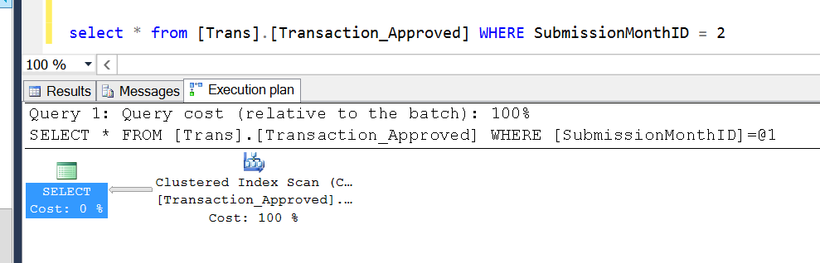
Parametrisation Example

Slide 22
Demo – Parameterisation

Slide 23
Bad plans
Skewed data
Parameter value not sniffed
Look for
Differing Actual v Estimate
Loop joins
Large reads/cpu
Odd behaviour
Look in DMVs for plans, running code in SSMS may result in a new good plan

Slide 24
Demo – Forced Parametrisation

Slide 25
Preventing Bad Plans
Keep statistics up to date
Recompile Procedure
OPTIMIZE FOR hint
Use Plan Guides

Slide 26
ORMs
nHiberbate/Linq
Adhoc Plan Caching
Server setting to cache on 2nd execution only to save memory

Slide 27
When do plans change?
Statistics Change
Evicted from memory
Based on usage and cost to generate
Different SET options – next demo
Object Changed
Forced Recompile
Server restart will clear plan cache

Slide 28
Demo – Arithabort On/Off
The query via the app is timing out
But it runs in SSMS in milliseconds

Slide 29
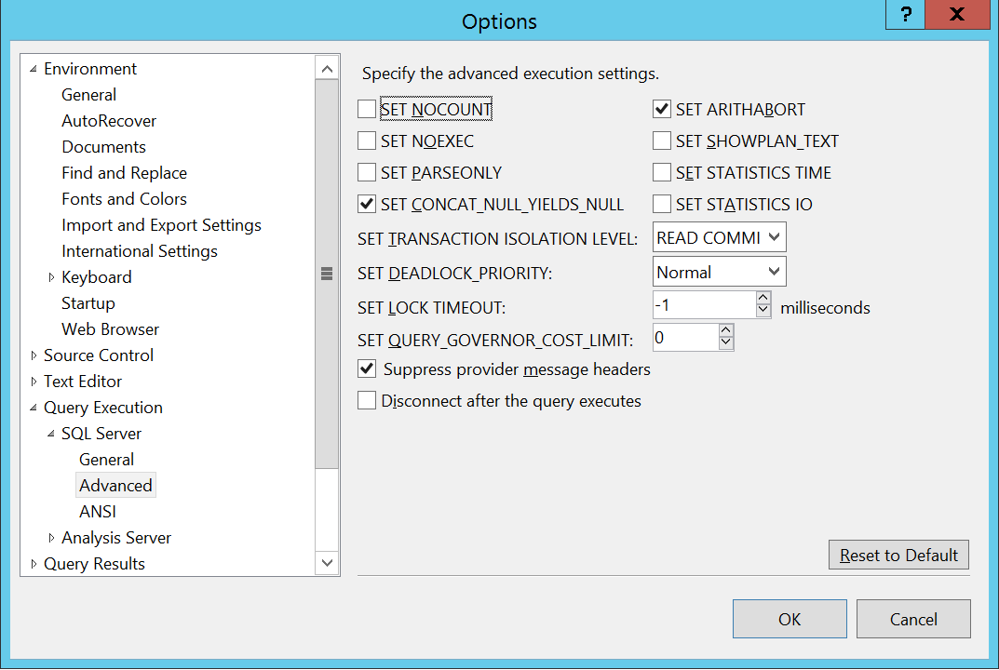
Remove the Arithabort Problem
Backwards compatibility to SQL Server 4.x!
Arithabort does nothing when ANSI Warnings is ON (which it always should be)

Slide 30
Parallelism
The use of multiple cpus/cores
Controlled by server level configuration
Overwritten by query hint (MAXDOP)
Not always possible
Distinct Count
Not always wanted
Skewed statistics leads to uneven threads (CXPACKET)
Cost Threshold dictates if it should be considered (Server level setting)

Slide 31
Memory Grants & Spills
Working memory space required to complete query
Lack of memory causes RESOURCE_SEMAPHORE waits
Memory grant is estimated
Based on estimated rows expected from each operator
Estimated space required to perform joins and aggregations
If under estimated the query will “spill” to tempDB
This is very bad
If heavily over estimated the server may run out of memory

Slide 32
Plan Operators

Slide 33
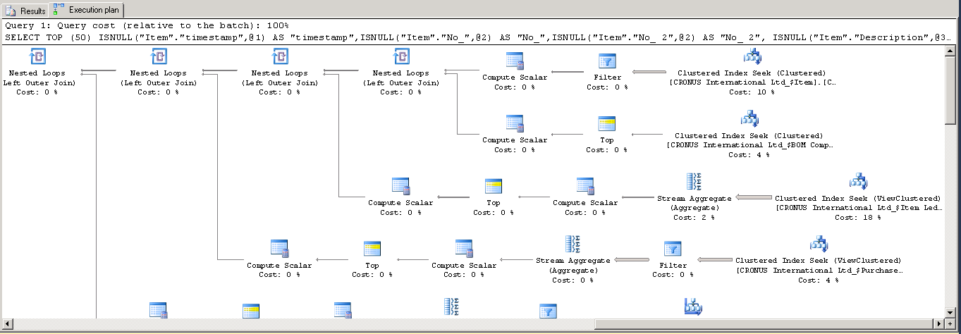
What do all these things mean?

Slide 34


Seeks and Scans
Seek
Usually preferred
Fast - direct to an index key
Scan
Reads all data in the table or a range
Slower if looking for a limited set of results

Slide 35



Join Types
LOOP
Fast for small datasets
Used for bookmark lookups
Bad is wrong estimates
MERGE
Very fast
Requires both sides to be sorted
HASH
Hashes data, heavy on CPU/tempdb
Best for very large joins

Slide 36



Costly Operators
Sort
Slow
Sometimes required (joins, aggs, grouping)
Bookmark Lookup
Non clustered index is not covering
Spools (several variations)
Storing workings in tempdb

Slide 37

Parallel Operators
Anything with this symbol
Look at the properties to see how many threads
Gatherer
Gathers parallel streams

Slide 38
What to look for in plans
Actuals vs Estimates
Statistics out of date?
Large arrows between operators
Usually from excessive scanning
Missing indexes?
Poor predicates?
Warnings (Yellow exclamation marks)

Slide 39
Hints

Slide 40
Hints
RECOMPILE/With Recompile
Prevents the plan from being cached
Parameterisation will not take place
FORCE ORDER
MERGE/HASH/LOOP Join
FORCE SEEK/SCAN
MAXDOP
INDEX [IndexName]
OPTIMIZE FOR/UNKNOWN

